Slide 1

Customer Shopping Behavior Analysis
A deep-dive into 3,900 transactions — uncovering revenue patterns, customer segments, and actionable insights for data-driven decision making.

Slide 2

Dataset Overview: 3,900 Transactions
18 Features
Spanning demographics, purchase history, and behavioral attributes
37 Missing Values
Review Rating gaps handled via category-level median imputation
$59.76
Average purchase amount across all transactions
3.75 / 5
Average customer review rating across the dataset

Slide 3
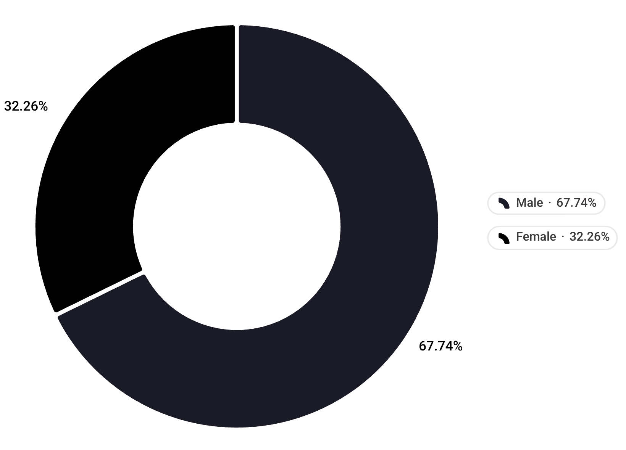

Revenue Split: Male Customers Drive 68% of Sales
Gender-Based Spending Breakdown
Male customers account for $157,890 — 67.7% of total revenue, while Female customers contribute $75,191 (32.3%).
This significant disparity is not merely a demographic coincidence — it signals a structural skew in either acquisition or purchasing patterns that warrants deeper segmentation analysis.
Targeted marketing campaigns toward female customers represent an underexplored growth lever.

Slide 4
Customer Segments: 80% Are Loyal Repeat Buyers
3,116
701
83
Loyal Customers
Returning Customers
New Customers
10+ purchases — representing 79.9% of all customers
5–9 purchases — representing 18.0% of all customers
Fewer than 5 purchases — representing 2.1% of all customers
The customer base is overwhelmingly retention-driven. New customer acquisition is minimal — this is a mature, sticky audience with strong habitual purchasing behavior.

Slide 5
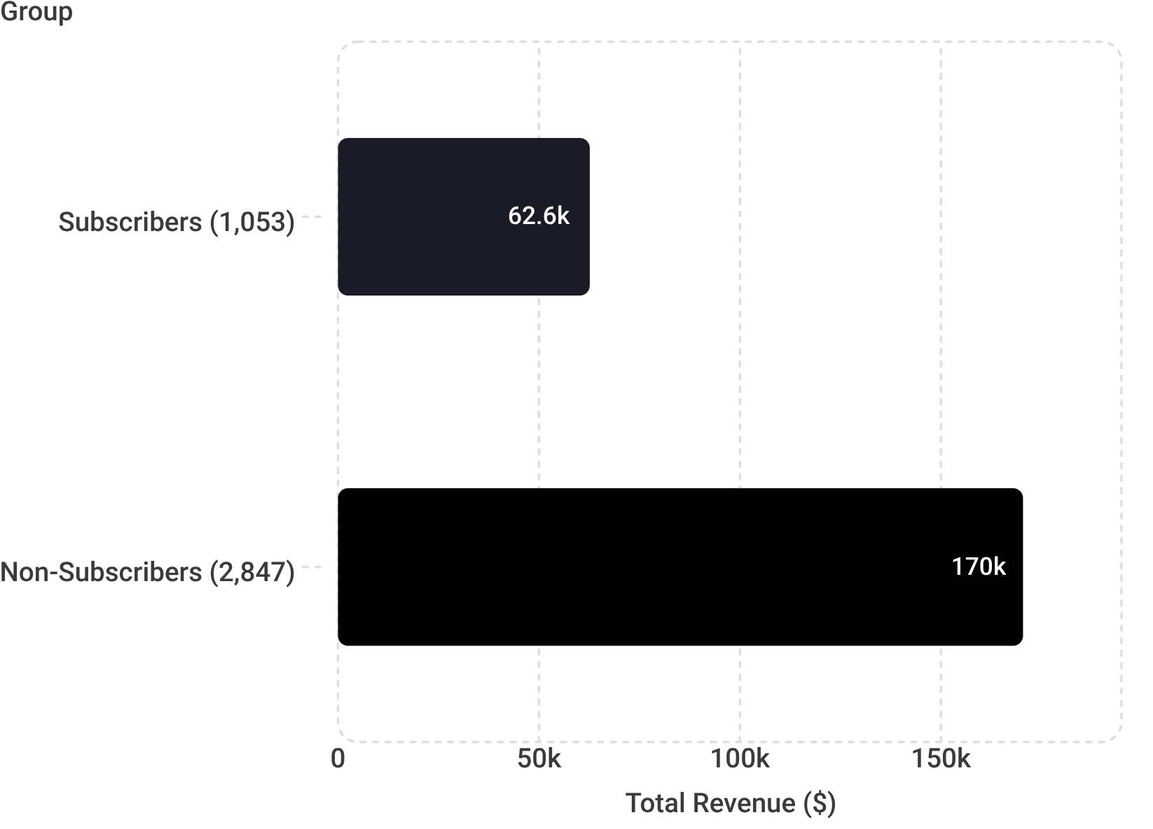

Subscription Paradox: Non-Subscribers Generate 73% of Revenue
The Volume Effect
Despite subscription programs typically rewarding high spenders, the per-customer average spend is nearly identical:
Subscribers: $59.49 avg spend
Non-Subscribers: $59.87 avg spend
The revenue gap is entirely explained by volume — non-subscribers outnumber subscribers by nearly 3:1. The subscription program is not creating a meaningful spend uplift per customer.
Current subscription benefits may not be compelling enough to drive adoption or incremental spend.

Slide 6


Top 5 Highest-Rated Products
1
2
3
Gloves
Sandals
Boots
3.86 avg rating
3.84 avg rating
3.82 avg rating
4
5
Hat
Skirt
3.80 avg rating
3.78 avg rating
Footwear and accessories dominate satisfaction metrics — a consistent signal that product quality and fit expectations are best met in these categories.

Slide 7
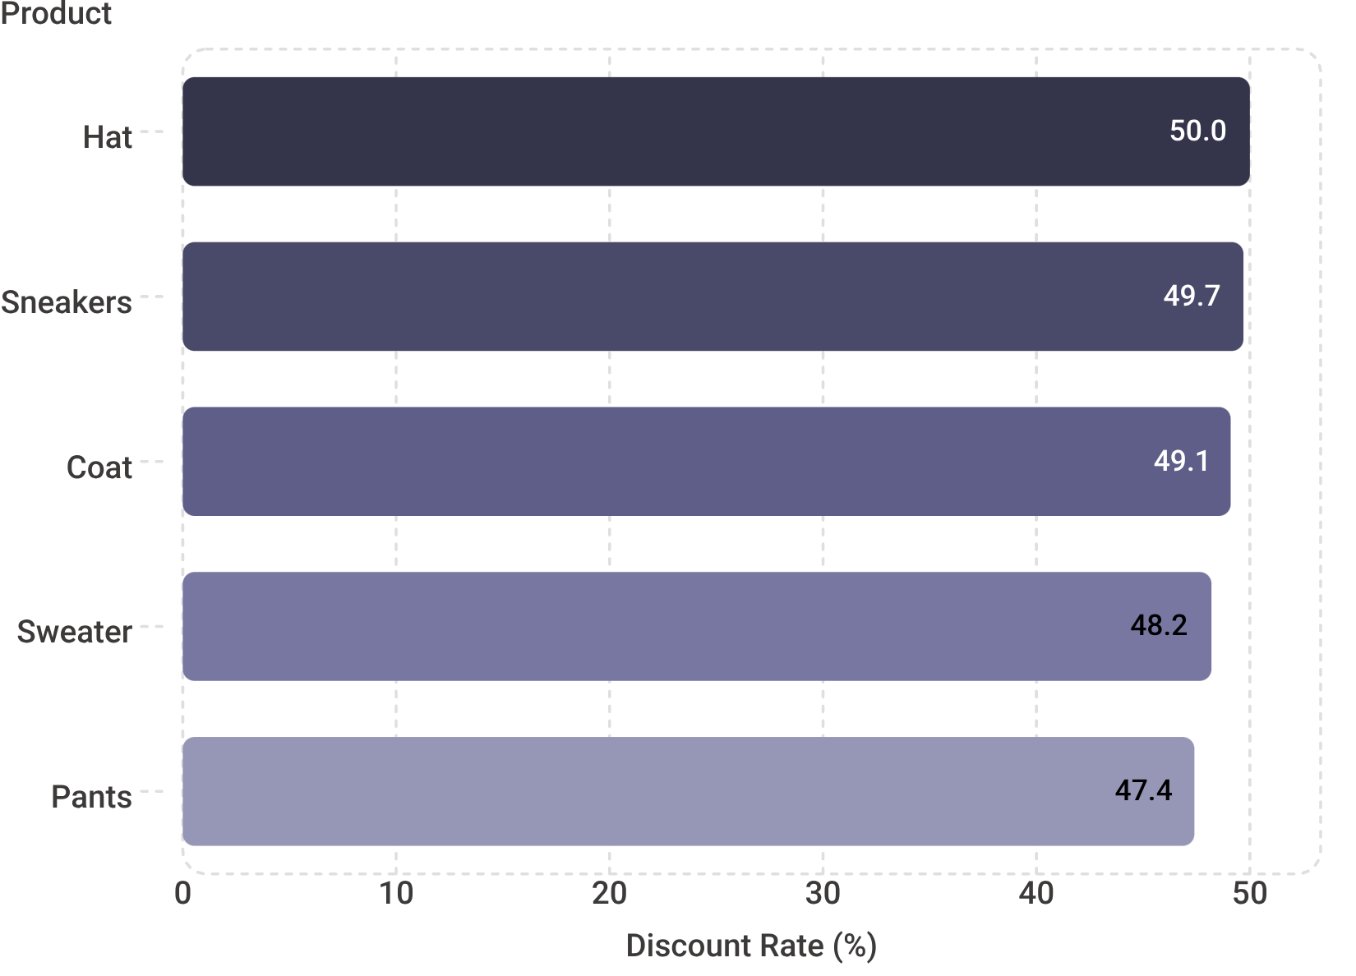

Discount Dependency: Hat Leads at 50% Discount Rate
High-Discount Products
Margin Risk Alert
These five products show the highest proportion of transactions involving a discount:
Nearly half of all transactions for these products involve a discount. While discounts drive volume, this level of dependency raises structural margin concerns.
Are customers conditioned to wait for discounts?
Is full-price demand being cannibalised?
Do these items generate positive contribution margin post-discount?
Heavy reliance on discounts may erode margins on these high-frequency items without driving net-new demand.

Slide 8
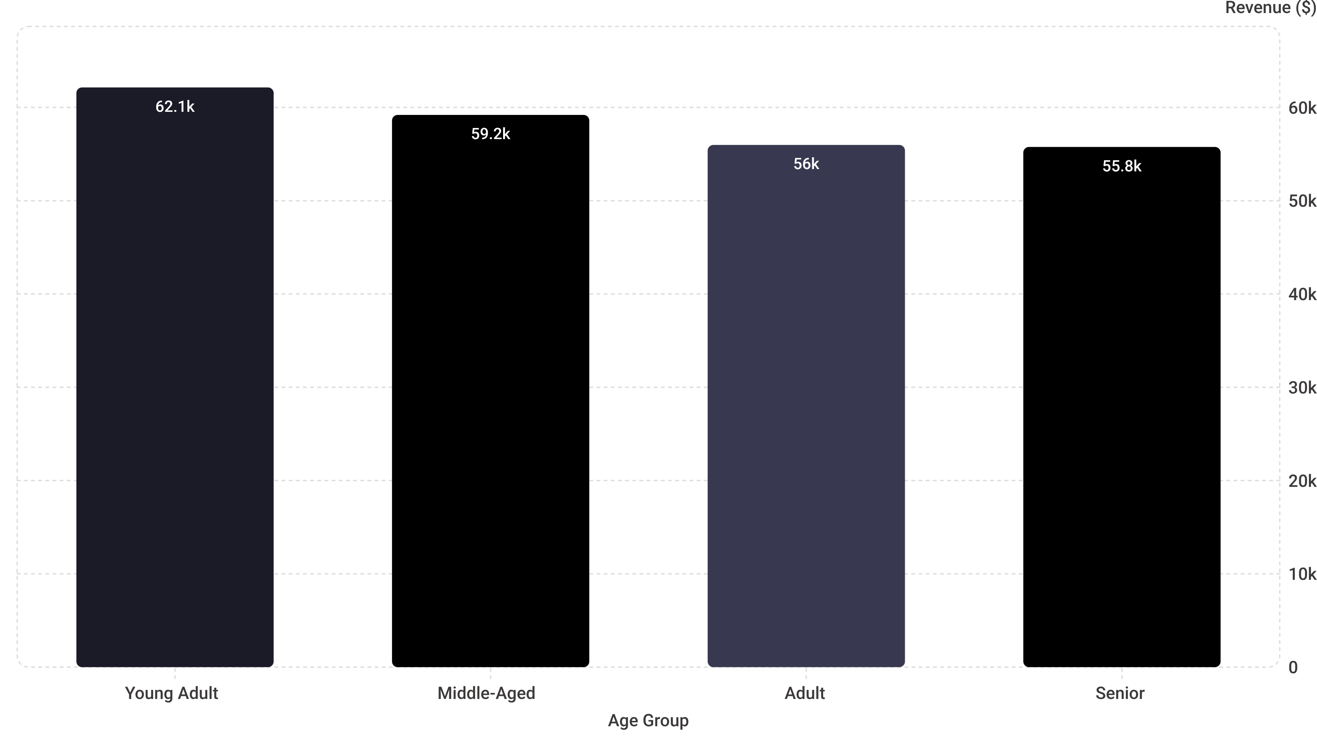
Revenue by Age Group: Young Adults Lead
Revenue is remarkably balanced across age groups — Young Adults lead at 26.6% ($62,143) but the spread between the top and bottom segments is only ~$6,400. This suggests consistent purchasing behavior across the full age spectrum, with Young Adults representing a slight but meaningful priority segment for personalized campaigns.

Slide 9


Strategic Recommendations
Subscription Growth
Increase adoption through exclusive benefits and loyalty rewards. The near-identical per-customer spend means volume is the lever — convert high-frequency non-subscribers first.
Discount Optimization
Optimize discount strategy by product category. Conduct margin impact analysis on Hat, Sneakers, and Coat — the top three discount-dependent items — before next promotional cycle.
Targeted Marketing
Prioritize Young Adults and the 3,116 Loyal customers with personalized campaigns. This cohort represents 79.9% of the customer base and is already primed for upsell and cross-sell.

